Slide 1


The Lost City of C

Slide 2
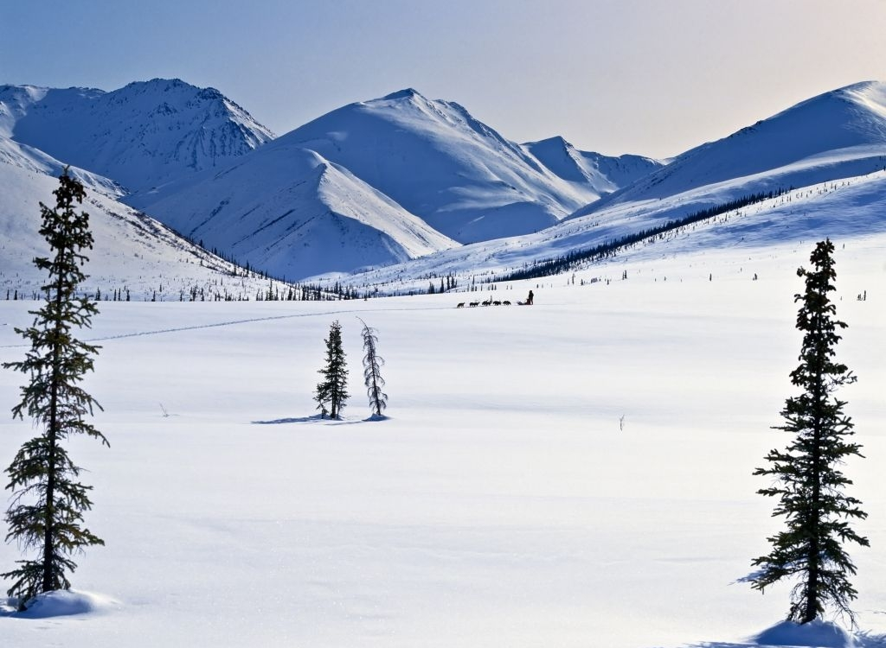
Notes:
Set the scene : The lost city of C is an ancient civilsation rumoured to be located in the middle of a barren landscape, a formidable,harsh, icy environment where no known inhabitants exist. You are to set out on the expedition to discover the new city and report back on what you find there including any signs of life, past or present.

Slide 3


Your team roles:
Choose a job for each member of your team (not on this list!)
Notes:
Think about qualities needed for the expedition eg, resilience, determination etc. Also think about different professions, your team will need qualified people to make a successful expedition. Monitor and guide here; doctors, navigators, scientists, writers etc.
Who were the people we chose and what were their qualities and Jobs.
IDEA: Add a spy from each team to get ideas from other teams.

Slide 4












Your survival kit:
Choose ten items. Think about these categories:
Notes:
Students choose 10 ítems. Again monitor and guide.
Extra ideas:
GPS
Mirror
Rubber bands
Go pro

Slide 5
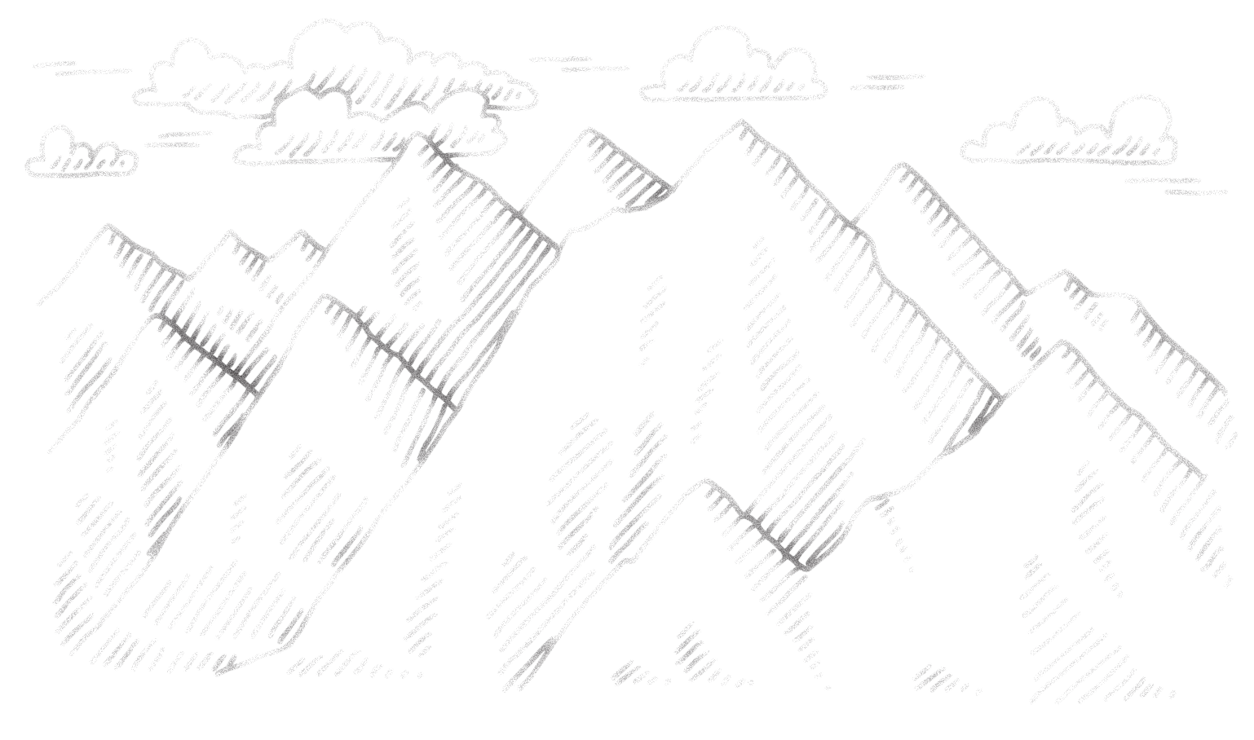

The expedition begins …
Each team starts with 10 expedition points.
The teams left with points at the end will have successfully accomplished their mission!
Any doubts, ask one of our survivalists!
Keep track of your scores!
Notes:
In reality we are only playing a few steps of this game so all of the teams will finish, just with differing amounts of points. If students are insisting that they have an ítem to fix the problem, allow them to have the point for thinking creatively.

Slide 6

Day 1 – We set off on our expedition at noon, full of high spirits. The weather was pleasant but soon the winds changed and we found ourselves in a snow storm, paralysed by the icy winds we…
Notes:
Sound effect of wind starts on click.

Slide 7
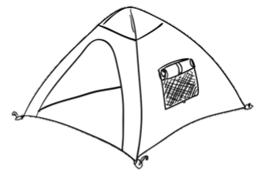
Did your team remember a tent or shelter?
If not, lose one expedition point.

Slide 8

Day 7 – After the awful winds of the past few days we were relieved to see the sun breaking through the clouds as we woke this morning. At around midday, whilst trekking along the ice, I felt a sudden crack beneath my feet, the last thing I remember was falling …
Notes:
Sound effect starts on click

Slide 9

Did your team pack a rope or something to help you escape?
If not, lose one expedition point.

Slide 10

Day 12 – The bad fall a few days ago has made me very cautious, I´m taking extra care with every step. We decided to avoid the same problem happening again by changing our route, turning to the east we …

Slide 11

Did your team pack a compass or a map? Do you have a navigator in your team?
If not, lose one expedition point.

Slide 12

Day 15 – Our change of route was certainly a wise decision, however this morning we were faced with a minor issue, an unmapped river blocking our way with no bridge to be seen…
Notes:
Sound effect starts on click.

Slide 13

Did your team pack anything to cross the river with?
If not, lose one expedition point.

Slide 14

Day 19 – Finally some good news from this mission, today we spotted what looked like a flowering red plant, on later inspection we discovered it was algae. A great Discovery, one to report back to our colleagues in …

Slide 15

Did your team pack a camera or do you have a botanist in the team?
If not, lose one expedition point.

Slide 16

Day 22 – The algae continues to make an impression, our team member who collected it has been suffering from nausea. We fear that the water may have been contaminated …

Slide 17

Did your team pack water purification tablets? Do you have a doctor, nurse or medic in your team?
If not, lose one expedition point.

Slide 18
Day 25 – Spirits have been low the past few days as we have battled icy winds and snow storms. We decided it was time to take shelter and try to lift the spirits with some light relief …
Notes:
Sound effects start on click

Slide 19
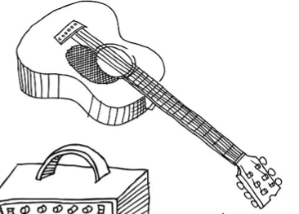
Did your team pack a musical instrument or a game? Or did you have an entertainer in the team?
If not, lose one expedition point.

Slide 20
Day 28 – Sheer excitement this morning as we encountered a waddle of penguins having a rest near our camp. We soon discovered that these intelligent creatures do have an angry side as one of the team got a little too close and a few of the penguins began frantically pecking at her feet …
Notes:
Sound effects start on click

Slide 21

Did your team pack something to distract the penguins while you make your escape?
Do you have a zoologist on your team?
If not, lose one expedition point.
ANY TEAM WHO ATTEMPTED TO HURT, MAIM OR KILL THE PENGUIN LOSES
5 POINTS!

Slide 22
Day 30 – We have learnt to keep our distance from the animals we encounter, observing at a distance. Today we stumbled across a group of indigenious people, keen to ask them for some advice on our route …

Slide 23

Did your team pack a language guide or dictionary?
Do you have a linguist or translator on your team?
If not, lose one expedition point.

Slide 24
Day 90 – As we passed over the final peak we saw an image in the distance, a figure we did not recognise, and in the background the shadow of a city, one like I have never set eyes on before. With a deep breath and a determined look we took our first steps toward …
Notes:
Sound effects start on click

Slide 25
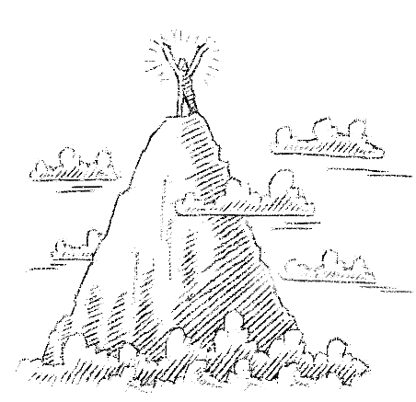
The Lost City of C
Mission accomplished!

