Slide 1
Linking, Supporting and Developing:
L.S.D to T.L.C
The Beginning of a Trip for Learner and Teacher
APPI Arcozelo Seminar
November 2018

Slide 2


Slide 3
Competition Time
What is the most difficult English Tongue-twister?
All British Passports were written in which language until 1858?
What could you legally post by parcel in America until 1913?
Why didn’t history students at Oxford University in its’ first year study the Aztecs?
What are “Crakpot”, “Halfenaked”, “Swetinbedde”, and “Gyldenbollockes”?
What does the word Lewstery mean?
If you move the letters YES back ten places in the alphabet , what word do you get?
What is the most common job of the wife of a millionaire?

Slide 4
Answers!
What is the most difficult English Tongue-twister?
  Pad kid poured curd pulled cod
All British Passports were written in which language until 1858?
  French
What could you legally post by parcel in America until 1913?
  Children
Why didn’t history students at Oxford University in its’ first year study the Aztecs?
  Because Oxford University was over 300 years old when the Aztec Empire was founded!
What are “Crakpot”, “Halfenaked”, “Swetinbedde”, and “Gyldenbollockes”?
  Medieval English Surnames
What does the word Lewstery mean?
  To bustle about like a lusty wench
If you move the letters YES back ten places in the alphabet , what word do you get?
  Oui
What is the most common job of the wife of a millionaire?
  A Teacher

Slide 5


Linking, Supporting and Developing
IN THIS PRESENTATION THERE ARE MANY REFERENCES TO “THE CUSTOMER” – WHO IS THE CUSTOMER?
IT IS YOU, IT IS ME, IT IS YOUR COLLEAGUES, IT IS YOUR FAMILY, IT IS YOUR STUDENTS
THIS IS NOT A DIRTY SALES THING – THIS IS A HUMAN THING.

Slide 6
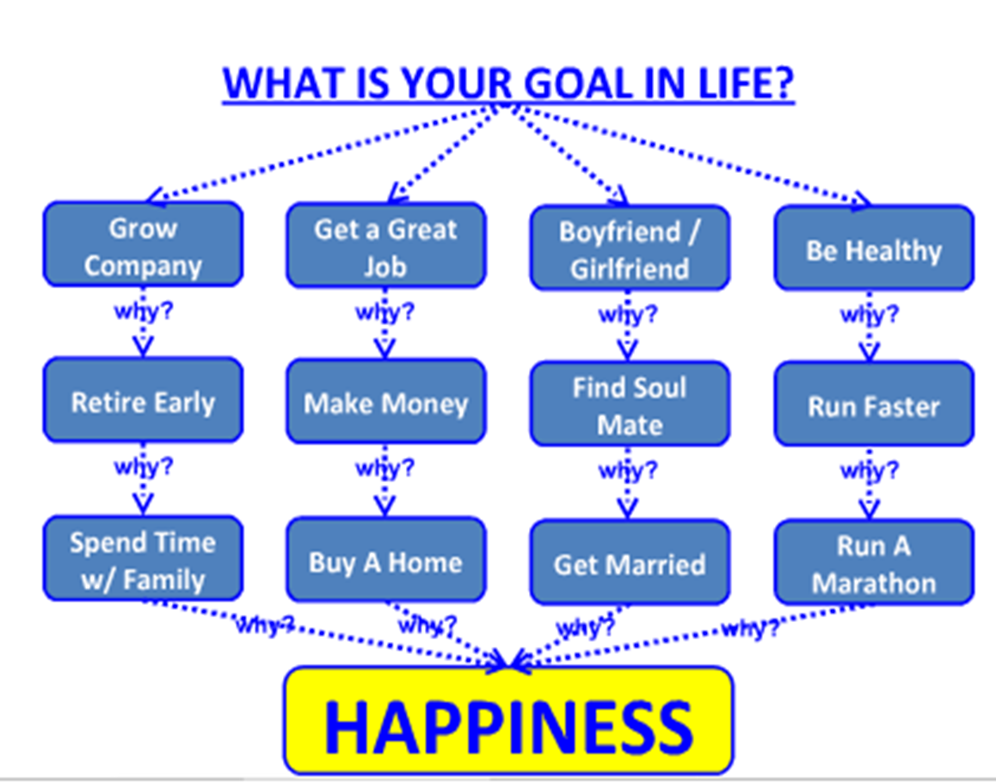
Linking, Supporting and Developing

Slide 7
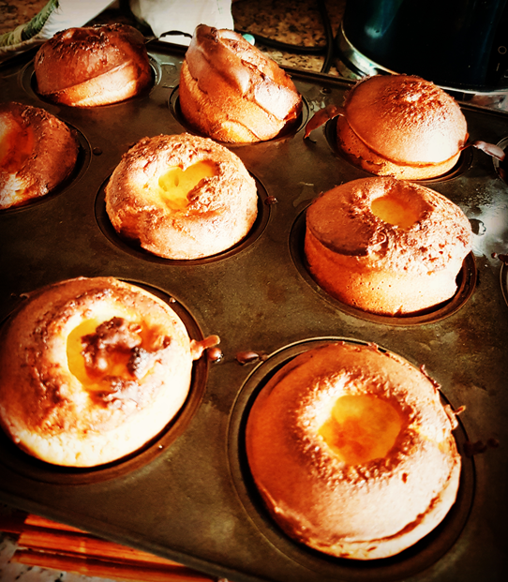

Slide 8
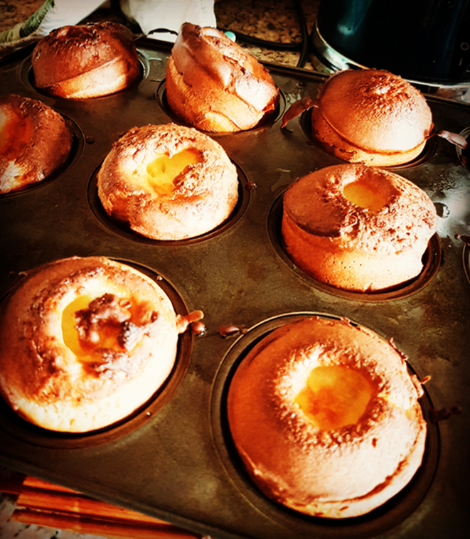
Yorkshire Puddings
140g plain flour (this is about 200ml/7fl oz)
4 eggs
200ml milk
sunflower oil for cooking
Heat oven to 230C/fan 210C/gas 8. Drizzle a little sunflower oil evenly into 2 x 4-hole Yorkshire pudding tins or a 12-hole non-stick muffin tin and place in the oven to heat through.
To make the batter, tip 140g plain flour into a bowl and beat in four eggs until smooth. Gradually add 200ml milk and carry on beating until the mix is completely lump-free. Season with salt and pepper. Pour the batter into a jug, then remove the hot tins from the oven. Carefully and evenly pour the batter into the holes. Place the tins back in the oven and leave undisturbed for 20-25 mins until the puddings have puffed up and browned. Serve immediately. You can now cool them and freeze for up to 1 month

Slide 9

Linking, Supporting and Developing

Slide 10
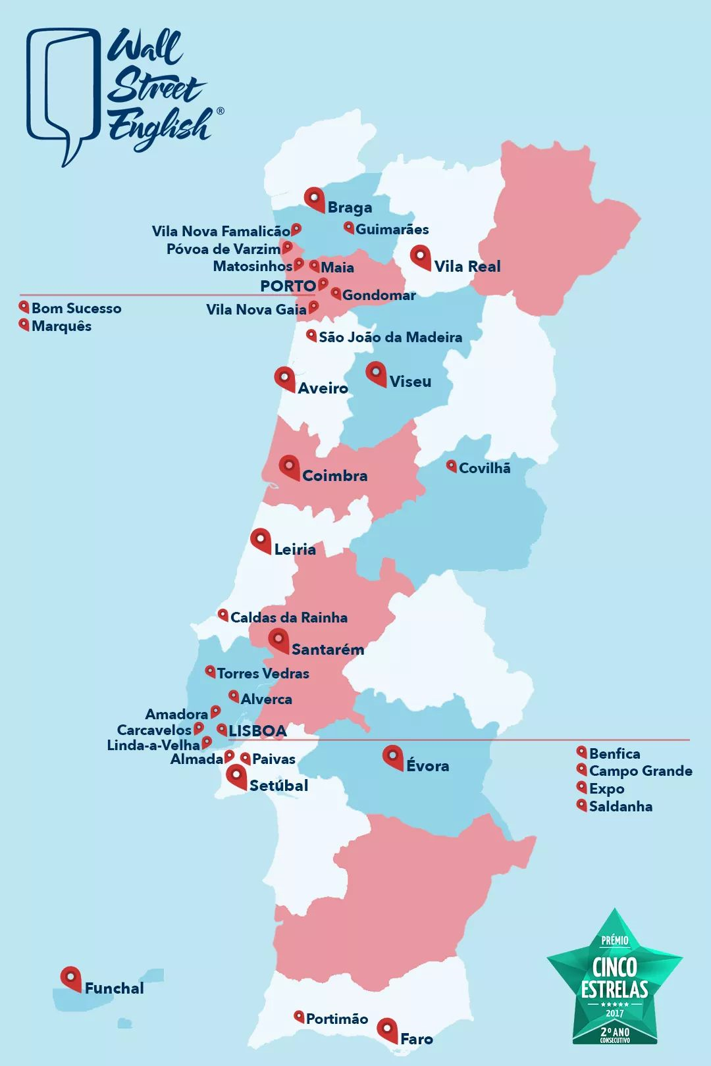
Linking,
Supporting, and
Developing

Slide 11
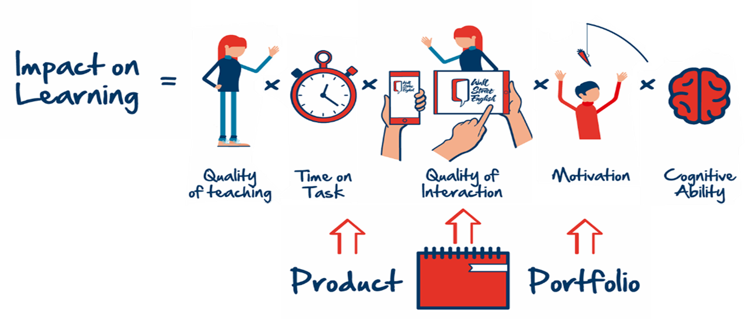
Linking, Supporting and Developing

Slide 12
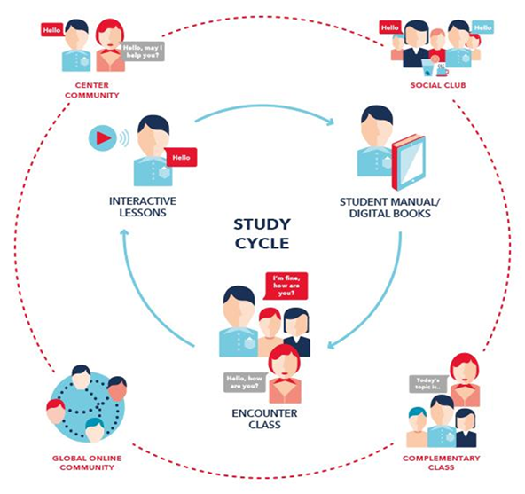
Linking, Supporting and Developing

Slide 13
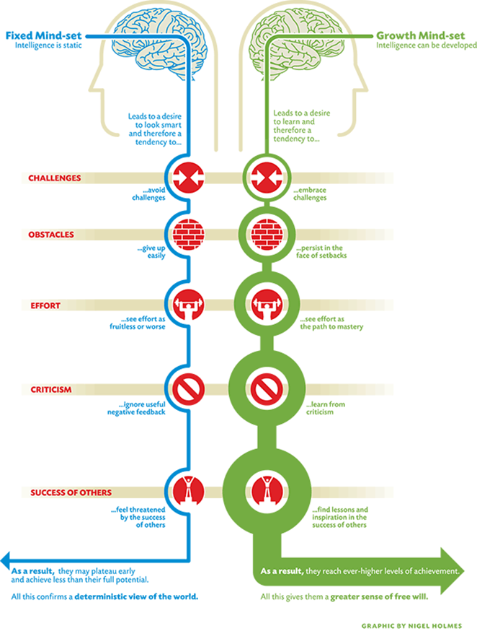

Slide 14
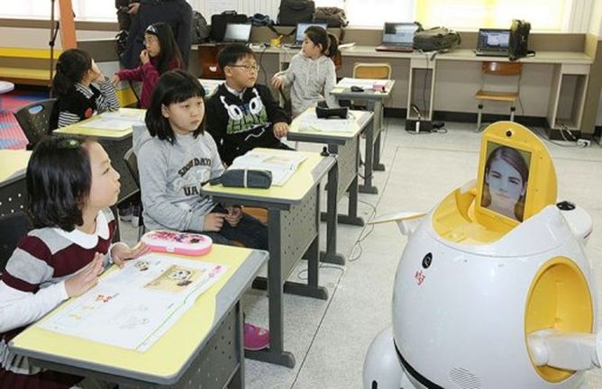
Linking, Supporting and Developing

Slide 15
Linking, Supporting and Developing
BE HUMBLE: IN THE BEGINNER’S MIND THERE ARE MANY POSSIBILITIES, IN THE EXPERTS MIND THERE ARE FEW.
  Shunryu Suzuki

Slide 16
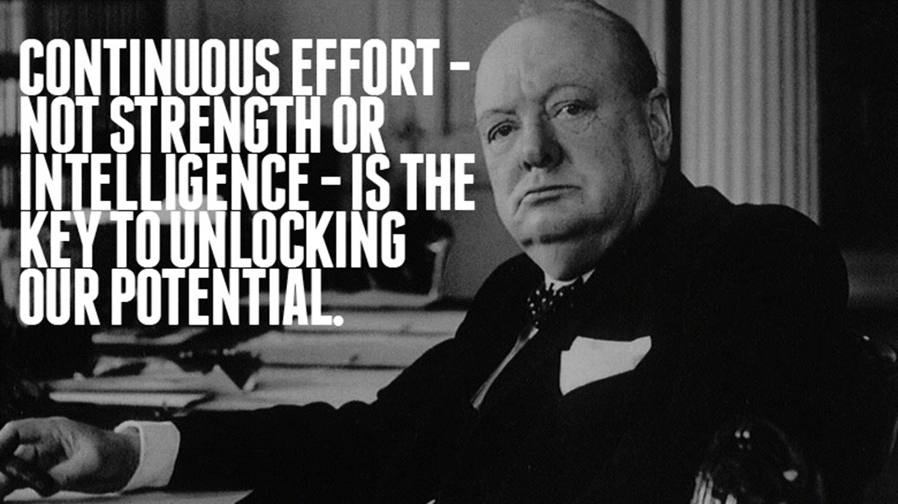
Linking, Supporting and Developing

Slide 17


Slide 18
Linking, Supporting and Developing
Physical customer experience is Price, Product, Location, Opening Times, etc..
50% of a customer experience is about Emotion.
“People buy Emotionally and then justify with logic.” Buck Rodgers (IBM)
The “buy” is not a financial transaction – It is an Emotional transaction - it is a student buying you as their Teacher.

Slide 19
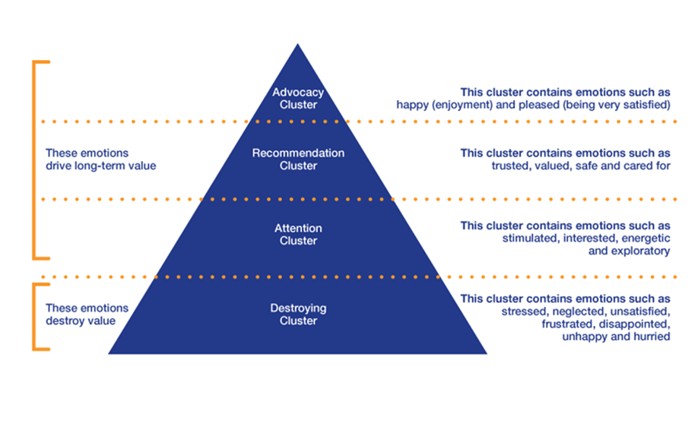
Linking, Supporting and Developing

Slide 20
Linking, Supporting and Developing
Recognize that customers decide emotionally and justify rationally.
Embrace the all-encompassing nature of customers irrationality.
Understand that customers’ minds can be in conflict with themselves.
Commit yourself to understanding and predicting customer habits and behaviors.
Uncover the hidden causes and unintended consequences of customers wanting things to be easy.
Accept that apparently irrelevant aspects of your customer experience are sometimes the most important aspects.
Realize that the only way to build customer loyalty is through customers’ memories.

Slide 21
Linking, Supporting and Developing
We want our students to have a unique, fun and memorable English language experience. We will achieve this by creating a warm, friendly, and welcoming environment where students feel relaxed and safe to explore the English language. All students will be respected and valued. They will be encouraged and given the opportunity to participate and socialize in a wide range of English language activities, coached to acquire English, and with each visit develop their comfort and confidence to use this amazing language. In everything we do we will aim to exceed students expectations, and will be proactive in anticipating our students needs and concerns. The result will be students leave feeling achievement, appreciated, refreshed, and expectant for their next visit. They will become advocates for the company.

Slide 22

Linking, Supporting and Developing

Slide 23
Linking, Supporting and Developing
Our idea of FUN is F.U.N
      FULFILLMENT
      UNIQUE
      NEXT

Slide 24
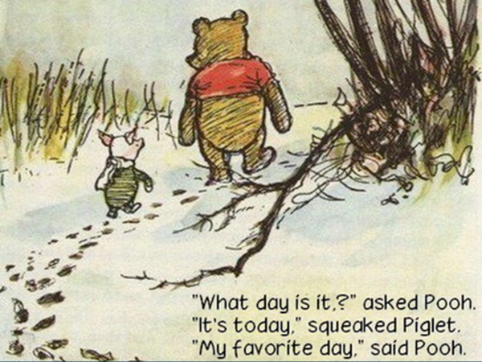
Linking, Supporting and Developing

Slide 25
Linking, Supporting and Developing
The only way to "find out if it will work out" is to do it.
To be innovative, you can't look to what others have done. The whole idea of blazing a path is that there was no path there before.
The goal is not simply to "work hard, play hard." The goal is to make your work and your play indistinguishable.

Slide 26
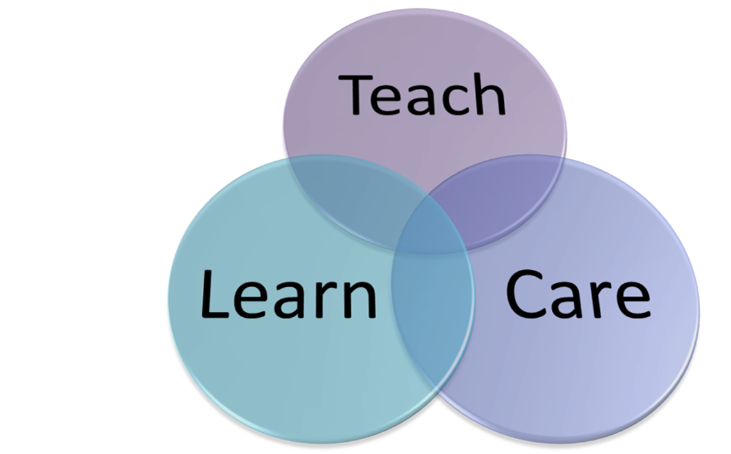

Slide 27
Linking, Supporting and Developing
Over 30 hours of Training each year – all Staff
Teacher Development aligned with Cambridge Assessment Teacher Framework
Professional Development Opportunities – Nationally and Internationally
Constant Support – WhatsApp, Visits, Observations, Training
Community Outreach – Make A Difference
Deliver Happiness

Slide 28
Linking, Supporting and Developing
Constant and Consistent Course Evolution
Meet Demands of Learners
Add Quality and Value to Learners
Add Variety and Dynamic to Teachers
Increase Quality and Satisfaction of Teachers
General English, Certification, Market Leader, Teaching Courses
Bring a Sense of Purpose, Belonging, and Meaningfulness

Slide 29
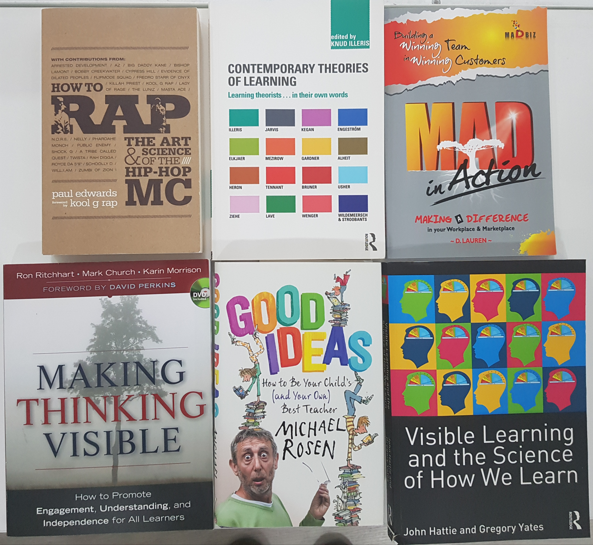
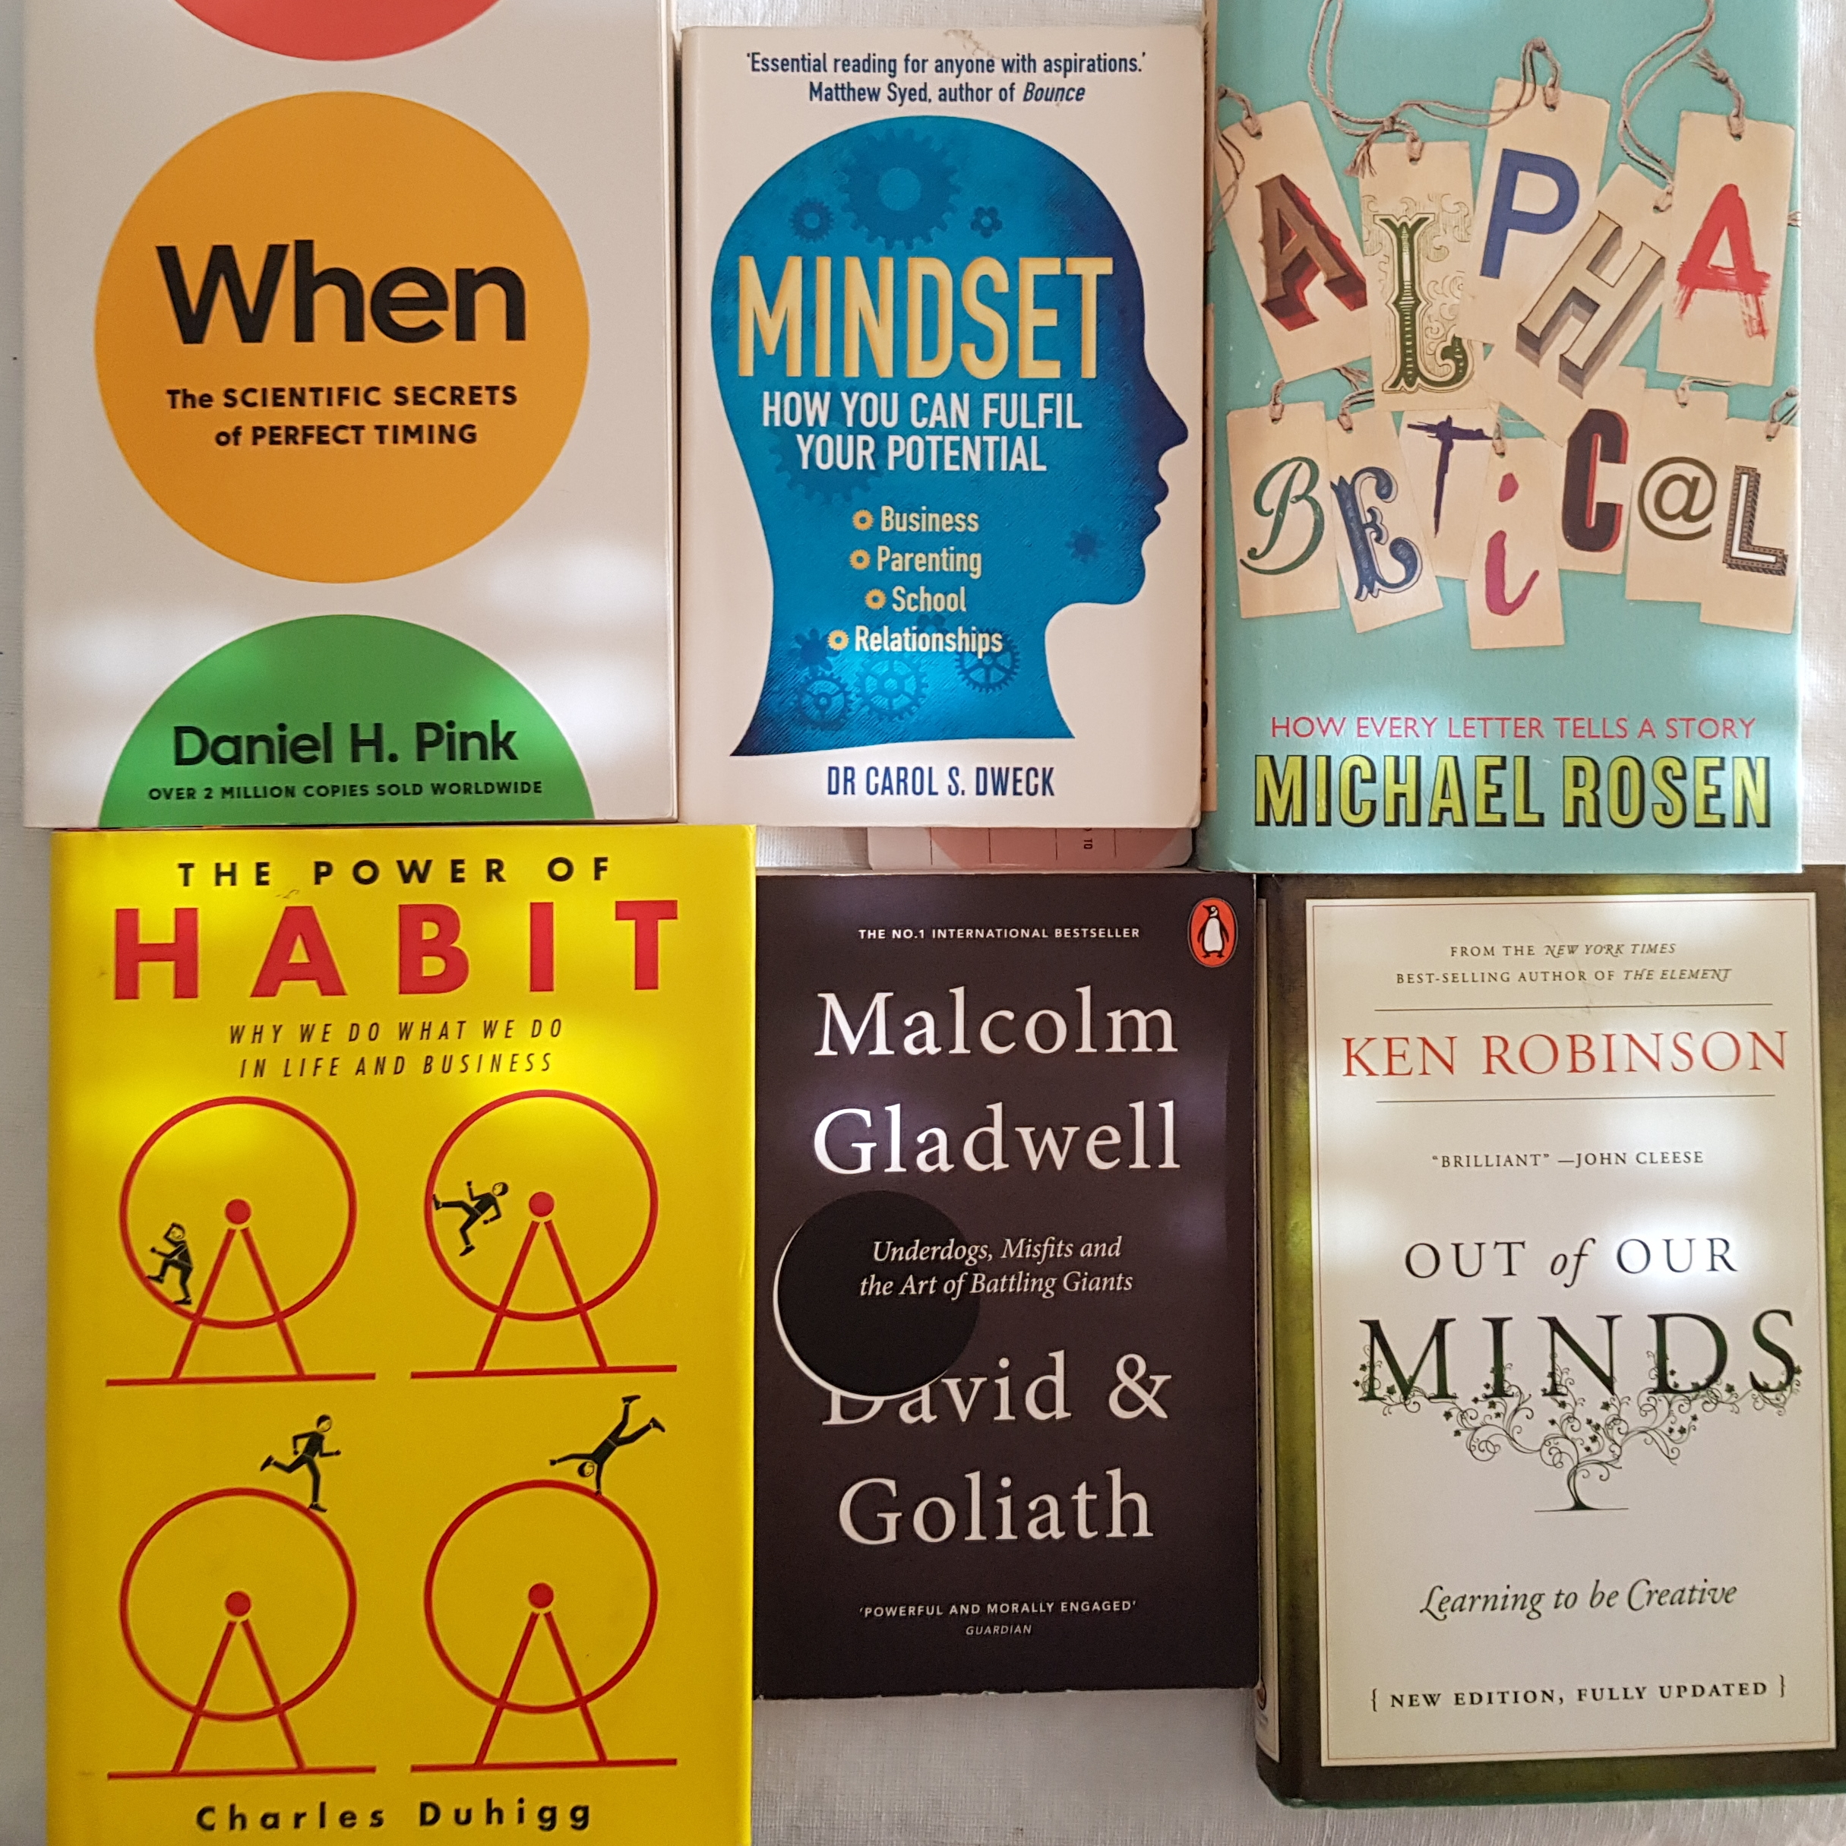
Linking, Developing and Supporting

Slide 30
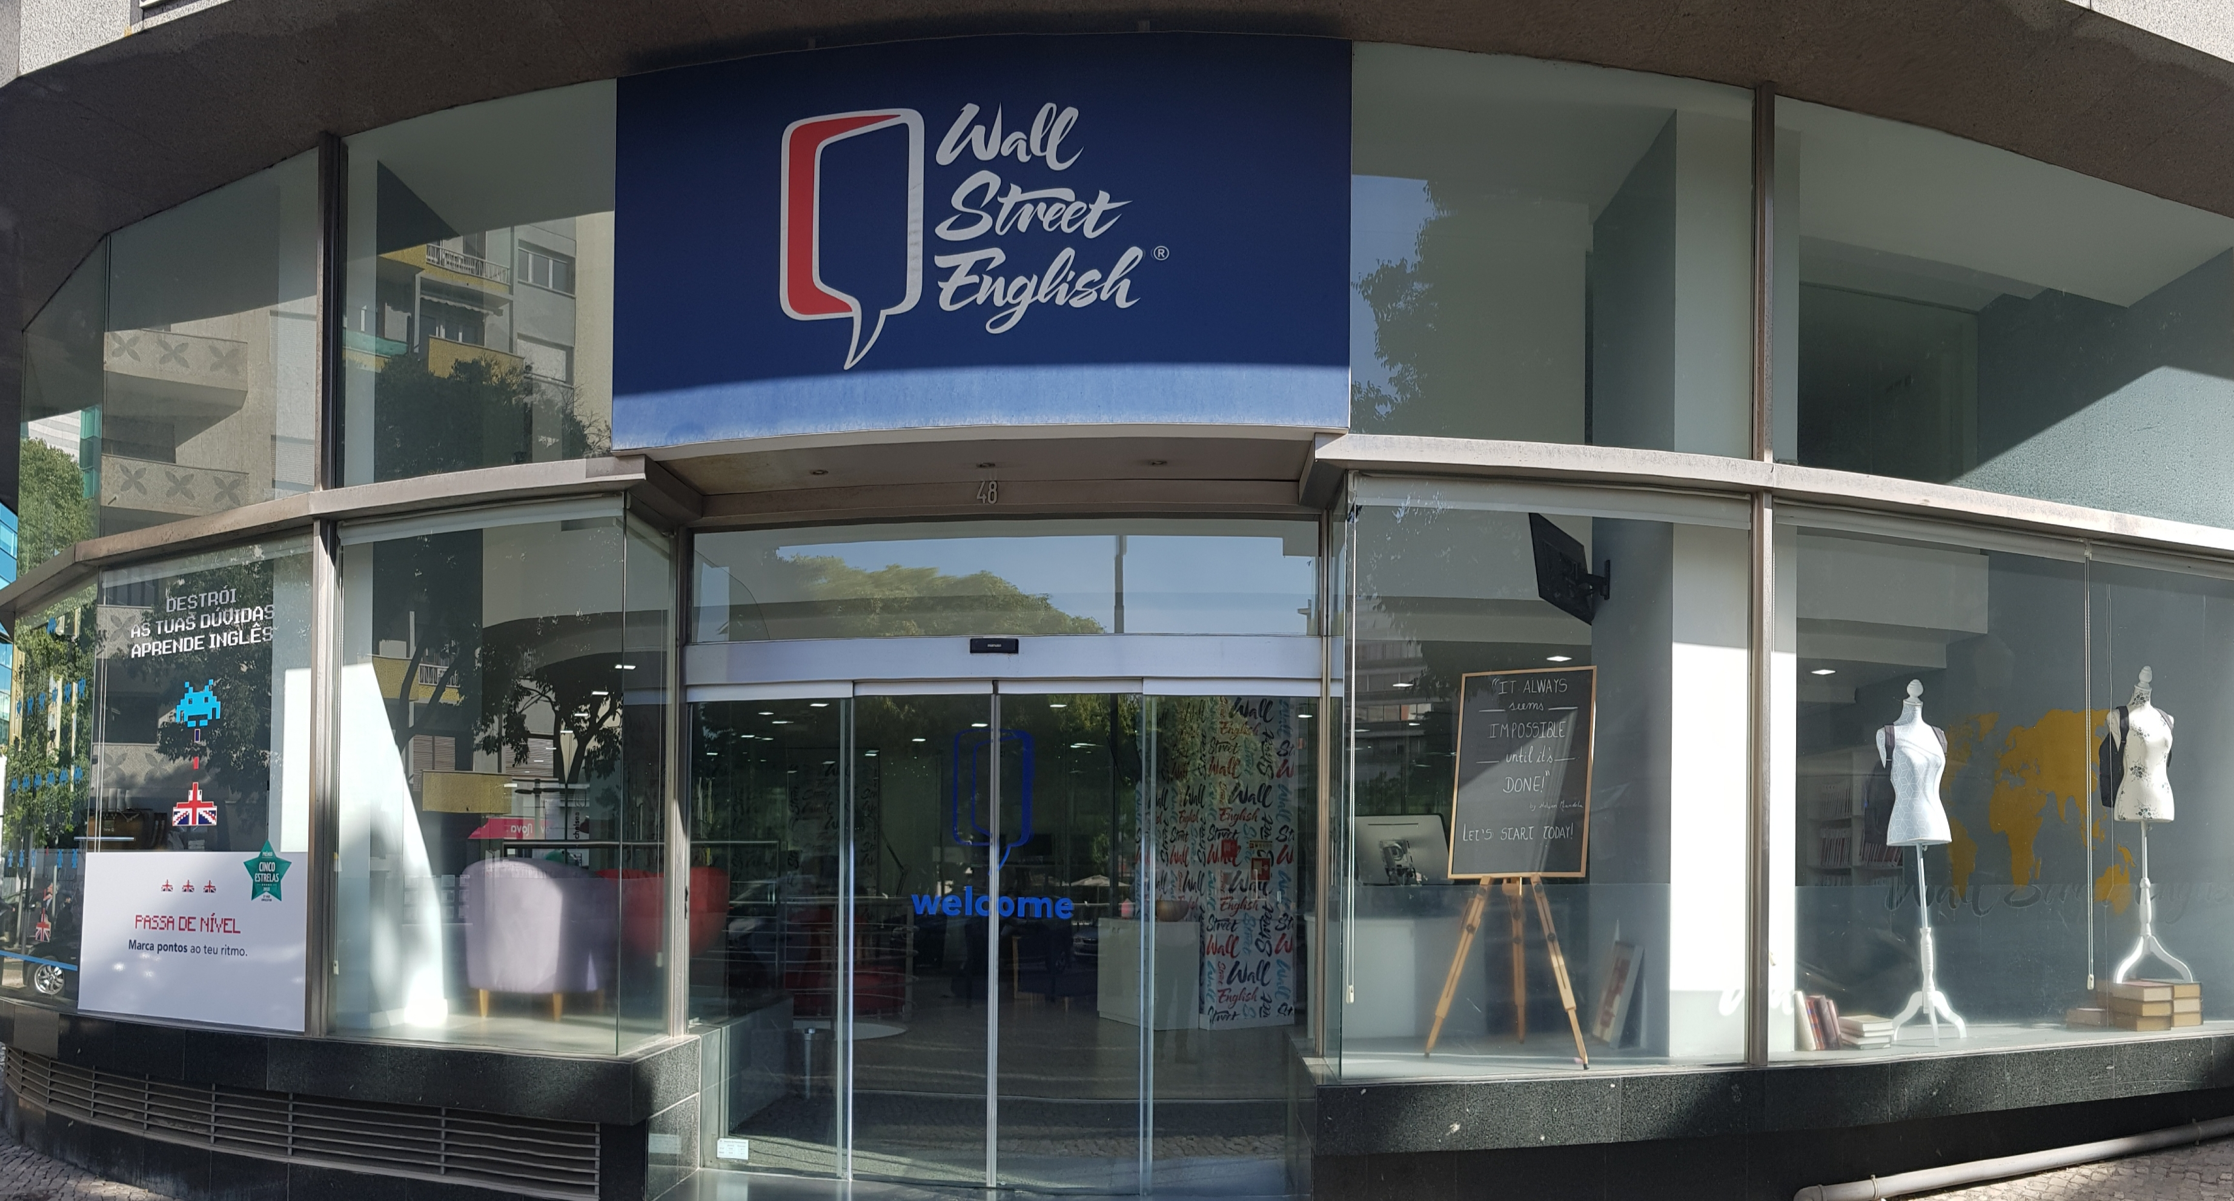
Linking, Developing and Supporting
Thank You!

